Slide 1
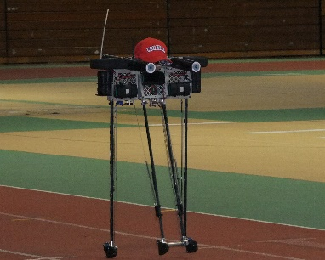


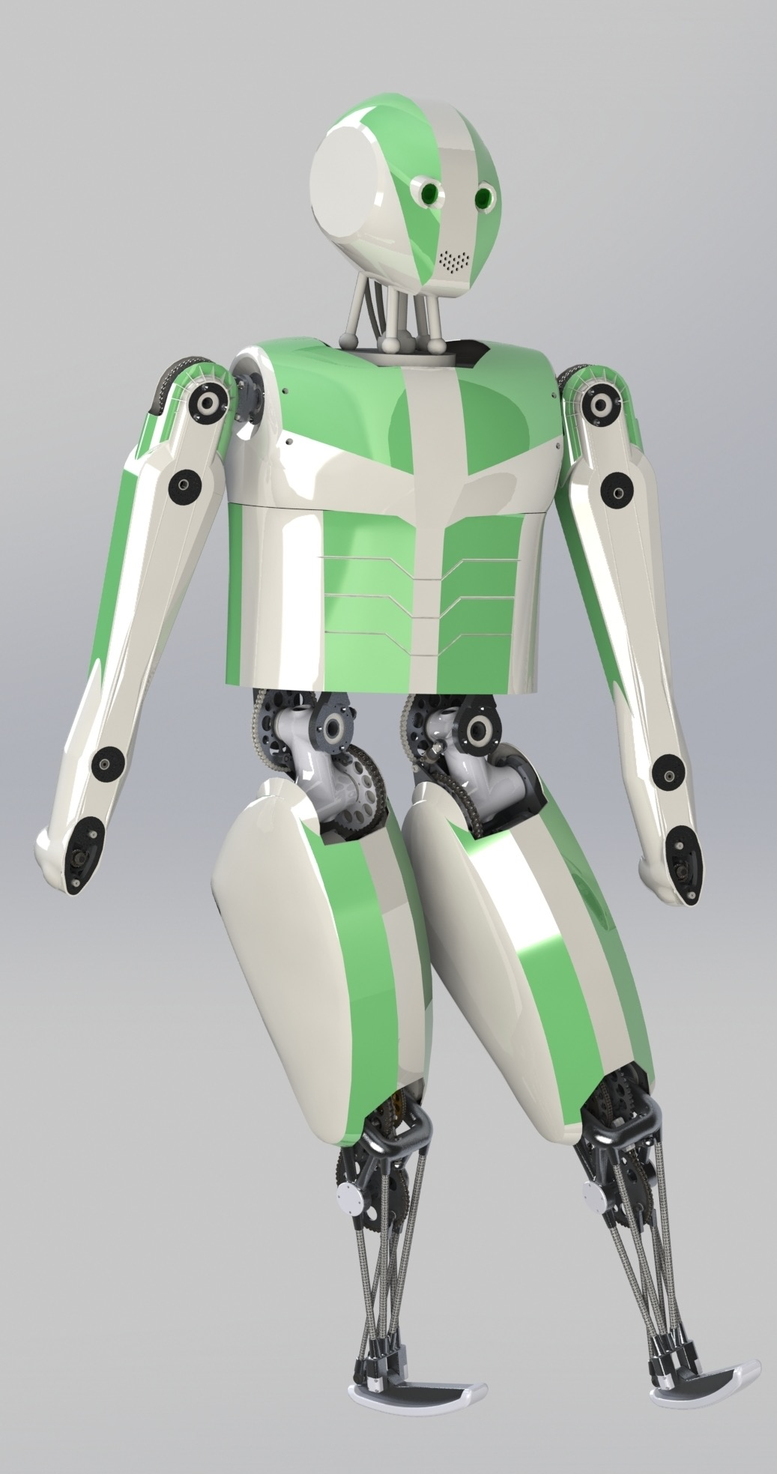
A new biped: CornellX MkIII
Agile and Efficient
Jason Cortell, Peter Baggaley, and Andy Ruina
Robust
Capable
3D
and efficient too
Robust balance
Cornell Ranger, 65 km
Fast foot placement
More speed, more torque
Robot | Motors | Mass | Peak joint power | CoT
Ranger | 3 | 10 kg | 100 W => 10 W/kg | 0.2
CornellX MkIII | 12 | 30 kg | 3000 W => 100 W/kg | 0.25
Fast foot placement AND low CoT
Fine-tuned motors, controllers, and transmissions
Low leg and motor rotor inertia
More stats Stairs, squats Up to 200 Nm joint torque 0.2 s leg swing Up to 15 rad/sec joint speed
1.5 m tall 0.8 m legs
Open source design
CornellX MkIII

Slide 2
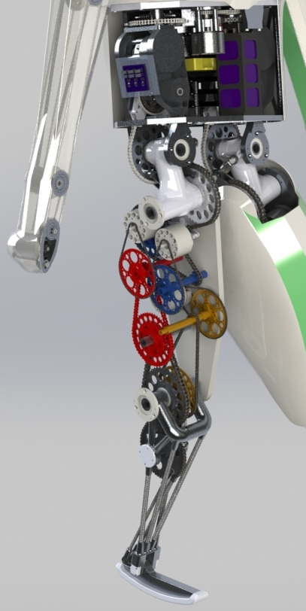
CornellX MkIII
Chains and sprockets + high power/weight, efficient, flexible - not modular, backlash, + cheap custom parts - bulky (36 chains & 72 sprockets)
Biarticular ankle and knee Low leg inertia
Collision tolerance Motor backs off at impact Low-inertia motor Series compliance Overload clutches
Electronics
Sensing and computing < 7 W
Custom motor controllers
2 angle sensors per DoF (motor + joint)
1 Atmel ARM MCU per motor
BeagleBone Black main brain, 1 GHz ARM
Drive mechanisms uncovered

