Slide 1
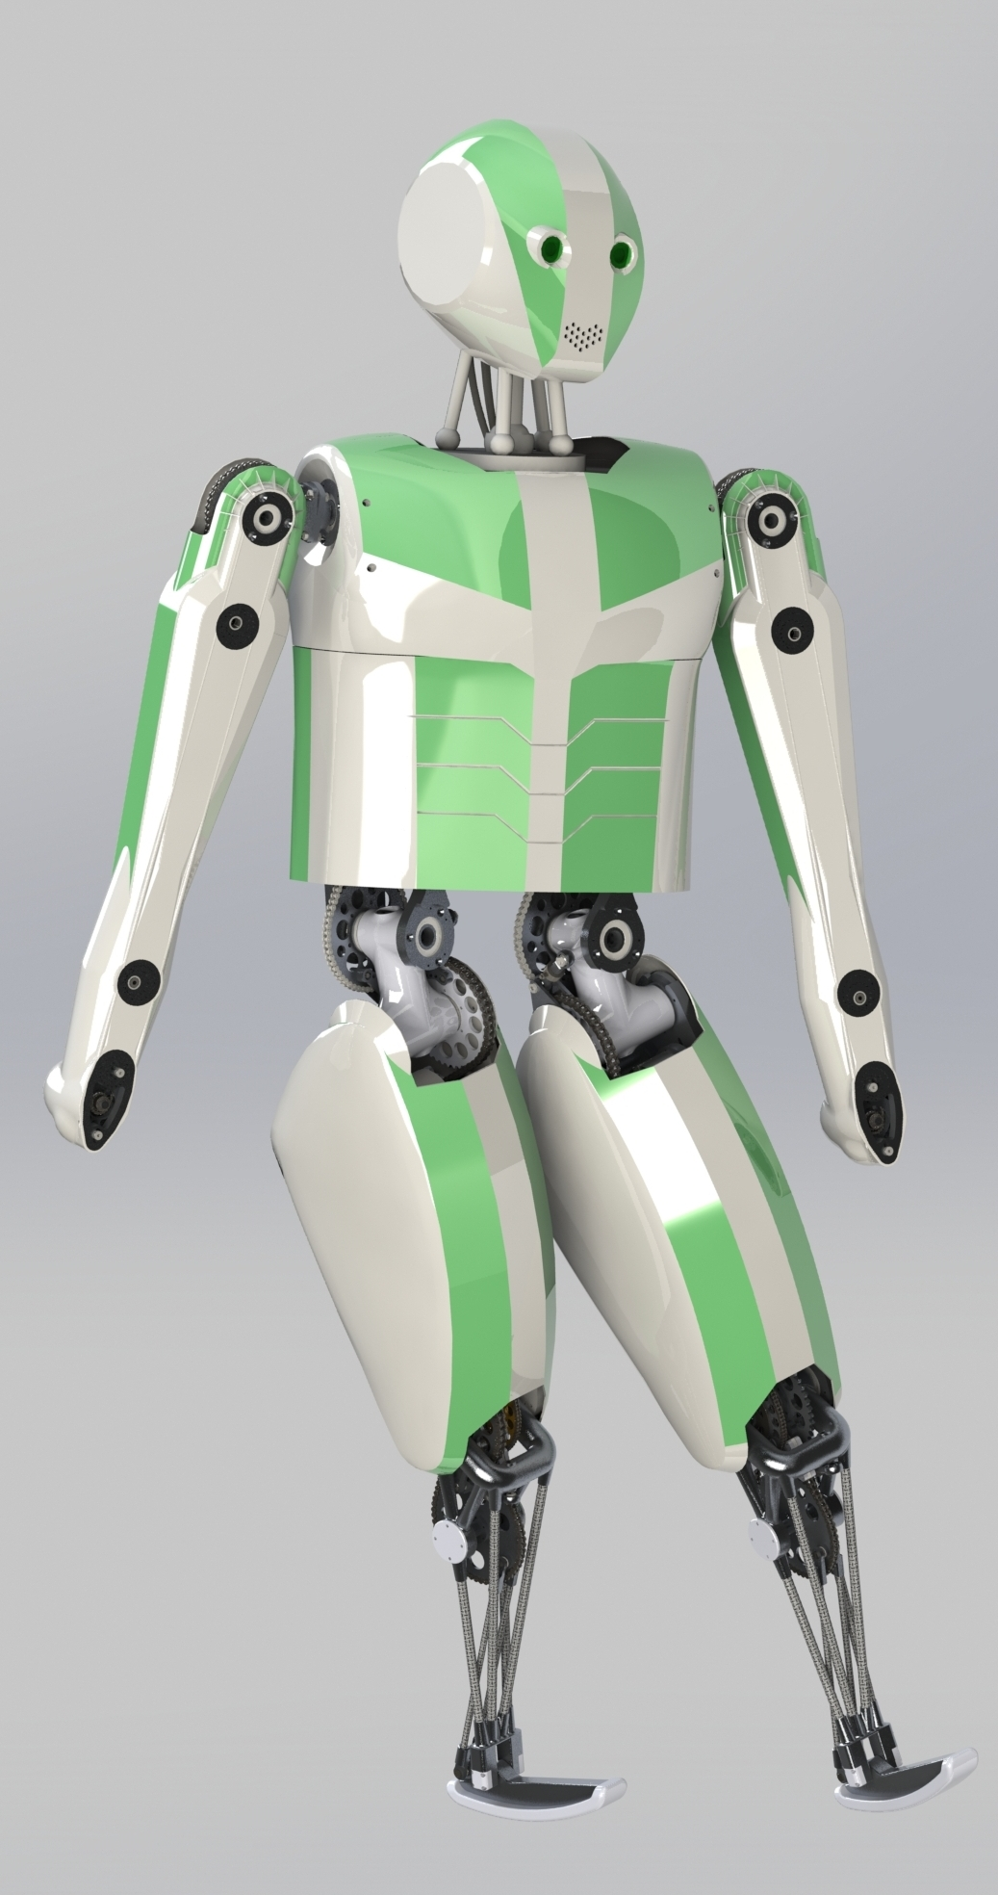
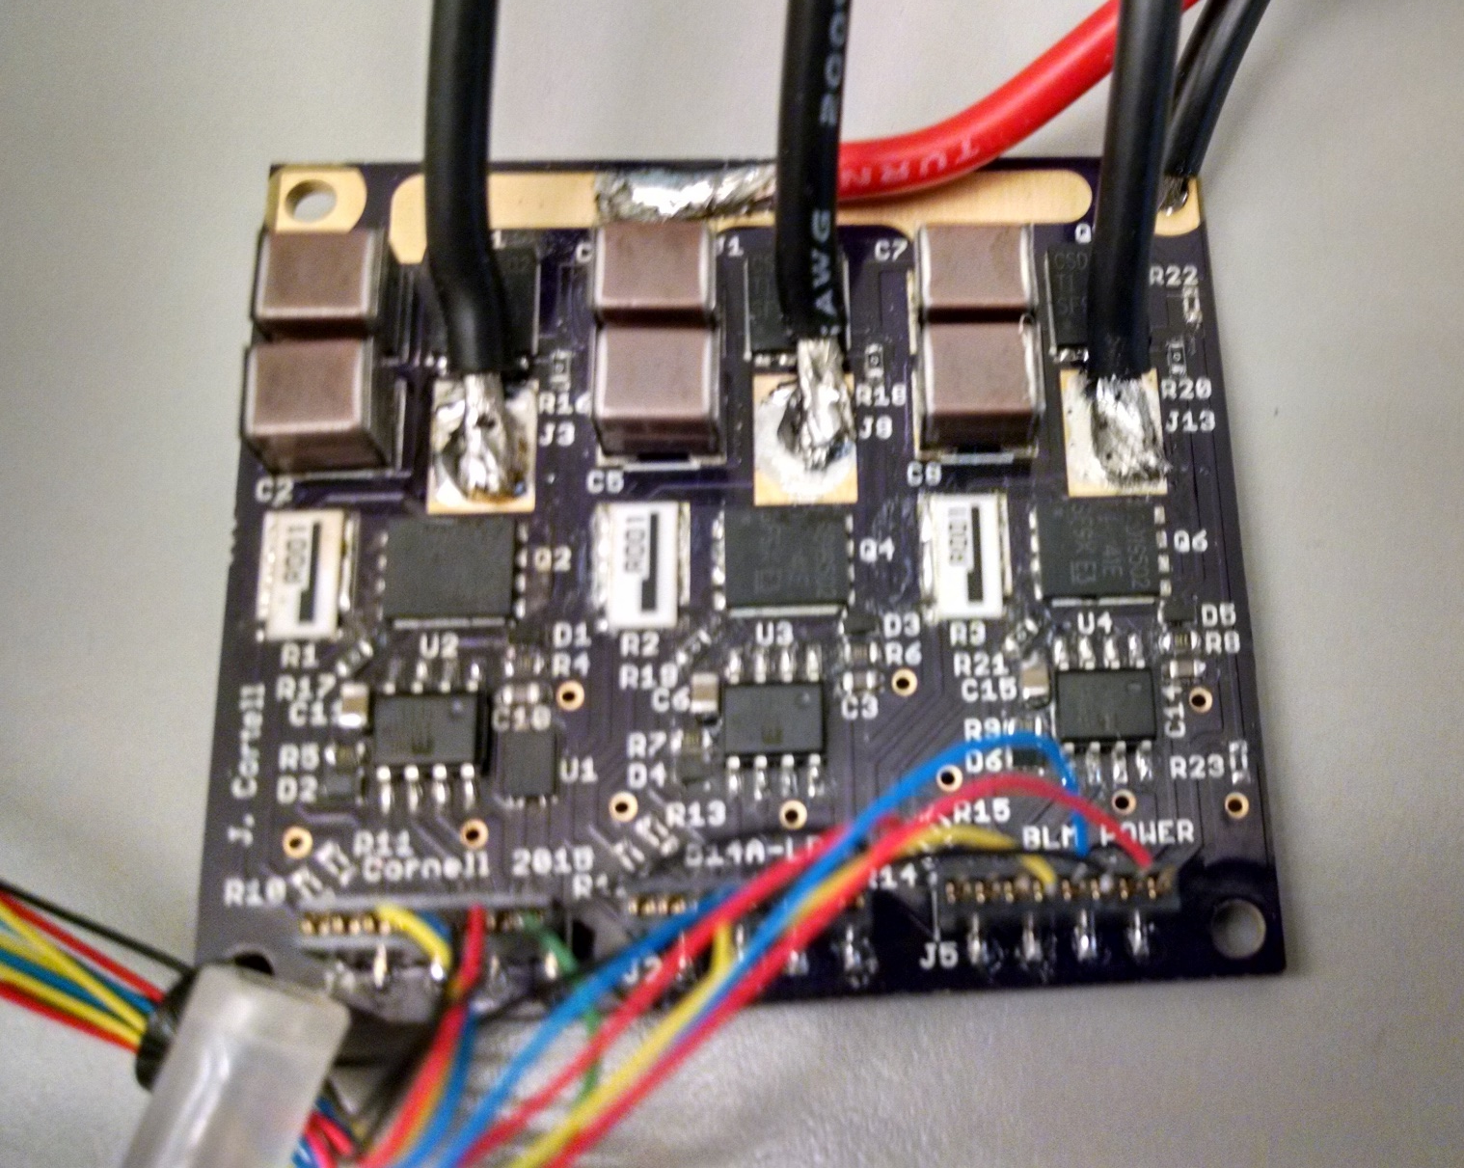


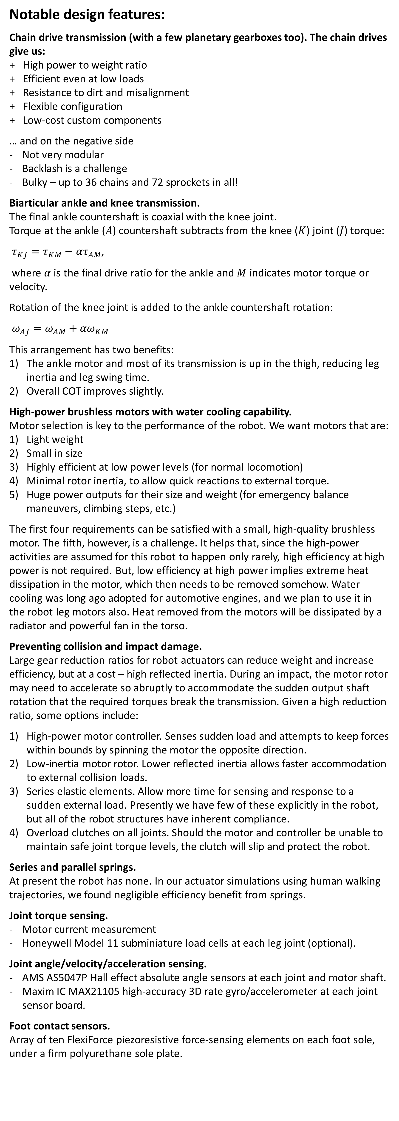
Introducing the Mk III Cornell Biped:
An Agile and Efficient Open-Source Legged Robot
Jason Cortell, Peter Baggaley, and Andy Ruina
Design intent – a Segway with legs, suitable for reliable locomotion in typical environments designed for humans:
Efficient walking: Cost of Transport (COT) ≈ human COT (power/weight/speed)
Robust balance, based on high-speed, high-accuracy foot placement
Deep knee bend, 100% duty cycle
Sit down, stand up
Climb steps and curbs, 25% duty cycle
Jog, dance, skip, hop, etc. (optional, but likely will follow from the above)
Resistance to impact and fall damage
Target specification:
A) Vital statistics
Height ≈ 1.5m (full robot as shown)
Leg length ≈ 0.8 m
Body weight ≈ 30 kg (full robot)
Lower body weight ≈ 20 kg (hip and legs only)
B) Joint arrangement
Foot (flexion only, no eversion/inversion at this time)
Knee
Leg swing
Leg adduction/abduction
Leg rotation (optional)
=> Ten lower-body actuated degrees of freedom (eight, if leg rotation is locked), in the order shown above
Plus two actuated degrees of freedom per arm (rotation and adduction/abduction), for swing and balance assist in testing the robot. A full version of the robot would normally have more arm degrees of freedom and hands or grippers of some sort, but this is a locomotion platform.
C) Actuator features
High-power brushless electric motors
Chain and planetary gear transmissions
Overload slip clutches
COT, walking ≈ 0.25 (including electronics and computers, thus putting it in the same range as that of a human. Note that the robot COT is estimated from a human walking gait; we can expect it to be lower for a robot-optimized gait, other things being equal.)
Leg swing time ≈ 0.2 sec for 0.5 radians, peak speed
Peak joint torque ≈ 200 Nm (leg swing and knees – this is a 500 N force at the end of a single 0.4 m limb, 1000 N for two legs, acting on a robot mass of 30 kg.)
Peak joint speed ≈ 15 rad/sec
Peak power ≈ 3 kW
Continuous torque ≈ 75 Nm
Continuous power ≈ 1.1 kW (with water cooling)
D) Electrical and computing
52 volt 230 W-hr high-power lithium polymer, 1.8 kg
10 km range, walking
Custom 80 amp motor control boards
Sensing and computing power < 5 W
Absolute angle sensors on all joints and motor shafts
Temperature sensors on all motor coils and driver boards
Rate gyros and accelerometers at each joint sensor board
BeagleBone Black top-level control board, with TI AM3359 1 GHz ARM processor
Atmel SAM4E and/or SAM7S microcontroller boards at each joint and motor (approx.)
Motor and sensor boards will communicate via CAN networks. The new Atmel support the new CAN-FD standard, which allows much faster communication than standard 1 or 2 Mbps CAN.
Ethernet is planned for communication between a top-level Linux board running ROS (Robot Operating System) and other computing and sensing devices.
Notable design features:
Chain drive transmission (with a few planetary gearboxes too). The chain drives give us:
+ High power to weight ratio
+ Efficient even at low loads
+ Resistance to dirt and misalignment
+ Flexible configuration
+ Low-cost custom components
… and on the negative side
Not very modular
Backlash is a challenge
Bulky – up to 36 chains and 72 sprockets in all!
Biarticular ankle and knee transmission.
The final ankle countershaft is coaxial with the knee joint.
Torque at the ankle ($A$) countershaft subtracts from the knee ($K$) joint ($J$) torque:
$τ_{KJ}=τ_{KM}−ατ_{AM}$,
where $α$ is the final drive ratio for the ankle and $M$ indicates motor torque or velocity.
Rotation of the knee joint is added to the ankle countershaft rotation:
$ω_{AJ}=ω_{AM}+{αω}_{KM}$
This arrangement has two benefits:
The ankle motor and most of its transmission is up in the thigh, reducing leg inertia and leg swing time.
Overall COT improves slightly.
High-power brushless motors with water cooling capability.
Motor selection is key to the performance of the robot. We want motors that are:
Light weight
Small in size
Highly efficient at low power levels (for normal locomotion)
Minimal rotor inertia, to allow quick reactions to external torque.
Huge power outputs for their size and weight (for emergency balance maneuvers, climbing steps, etc.)
The first four requirements can be satisfied with a small, high-quality brushless motor. The fifth, however, is a challenge. It helps that, since the high-power activities are assumed for this robot to happen only rarely, high efficiency at high power is not required. But, low efficiency at high power implies extreme heat dissipation in the motor, which then needs to be removed somehow. Water cooling was long ago adopted for automotive engines, and we plan to use it in the robot leg motors also. Heat removed from the motors will be dissipated by a radiator and powerful fan in the torso.
Preventing collision and impact damage.
Large gear reduction ratios for robot actuators can reduce weight and increase efficiency, but at a cost – high reflected inertia. During an impact, the motor rotor may need to accelerate so abruptly to accommodate the sudden output shaft rotation that the required torques break the transmission. Given a high reduction ratio, some options include:
High-power motor controller. Senses sudden load and attempts to keep forces within bounds by spinning the motor the opposite direction.
Low-inertia motor rotor. Lower reflected inertia allows faster accommodation to external collision loads.
Series elastic elements. Allow more time for sensing and response to a sudden external load. Presently we have few of these explicitly in the robot, but all of the robot structures have inherent compliance.
Overload clutches on all joints. Should the motor and controller be unable to maintain safe joint torque levels, the clutch will slip and protect the robot.
Series and parallel springs.
At present the robot has none. In our actuator simulations using human walking trajectories, we found negligible efficiency benefit from springs.
Joint torque sensing.
Motor current measurement
Honeywell Model 11 subminiature load cells at each leg joint (optional).
Joint angle/velocity/acceleration sensing.
AMS AS5047P Hall effect absolute angle sensors at each joint and motor shaft.
Maxim IC MAX21105 high-accuracy 3D rate gyro/accelerometer at each joint sensor board.
Foot contact sensors.
Array of ten FlexiForce piezoresistive force-sensing elements on each foot sole, under a firm polyurethane sole plate.
Motor and transmission optimization
We would like to optimize the hardware for efficient walking, but how – with no finished design, no optimized trajectories? Solution: we put the robot’s actuators through a human gait trajectory, using Winter’s joint kinematics and moments measured from a walking human (“Biomechanics and Motor Control of Human Movement, 2009), but with the moments scaled to the weight of the robot. This helped us select suitable motors, gear ratios, and spring constants.
For practical reasons we cannot entirely use the optimized ratios in the table above, and instead are using the ones in the right column. The biggest change is at the knee – using such a low gear ratio would not allow high-torque knee actions like sitting or step climbing. Nearly all of the increase in COT shown above is due to this increased gear ratio at the knee. Evidently there is a lot of knee swinging at low torque during human walking, such that an increased gear ratio and higher motor speeds leads to much higher motor iron (friction) losses and inertia losses.
The change in ankle/knee ratio is also large, but has a negligible effect on the COT, increasing it only from 0.2196 to 0.2210.
Parameter | Optimized for efficient walking | Overall design choice
Leg swing gear ratio | 64:1 | 69:1
Knee gear ratio | 37:1 | 69:1
Ankle gear ratio | 76:1 | 77:1
Ankle/knee “biarticulation” ratio | 8.7:1 | 4.3:1
COT (motor electrical) | 0.22 | 0.24
Test version of the 60-volt 80-amp motor driver (amplifier) board. Actual size is 50 mm x 50 mm. The test board shown here is made of normal FR4 fiberglass, but the full-power versions will be built on thin copper plates. Solid copper construction permits rapid heat flow down through the board and into a heat sink or water cooling jacket. A control board, still being developed, mounts on top of the driver board and provides measurement, control, and communications.

