Slide 1

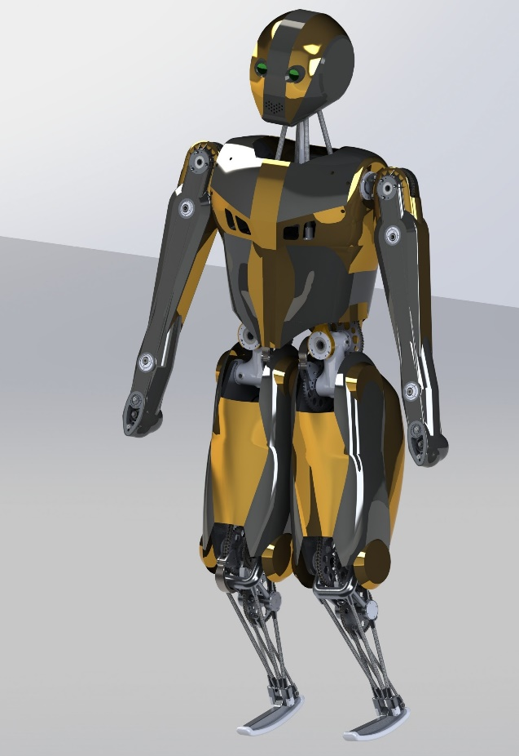
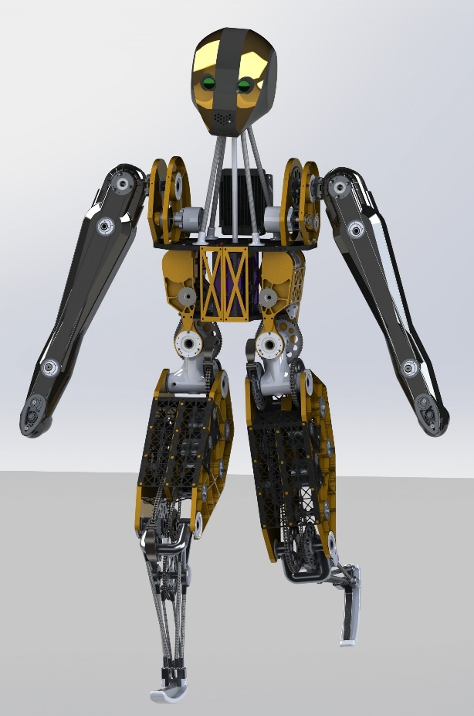
Motors and transmissions for nimble robots, exoskeletons, and prosthetics.
Jason Cortell
Biorobotics Laboratory
Cornell University
June 5, 2016
Dynamic Walking

Slide 2
Not required...
1) Direct drive motors. Heavy, with lots of waste heat.
2) Energy-storage springs. Complex and hard to control.
3) Hydraulic actuators. Inefficient and expensive.
4) Pneumatic actuators. Hard to control and even less efficient.
5) Harmonic drives. Expensive, inefficient and add inertia.
6) Gadgets. Special variable-ratio transmissions, clutches, etc. add weight, complexity, and control challenges.
We believe that nimble and efficient robots can be built without any of these things.

Slide 3
Don’t be afraid of gear reduction
Gearboxes don’t have to add inertia, if the motor size is reduced accordingly.
Given 3 conditions:
- no-friction no-inertia gearboxes
motors have similar design
Motors are scaled so that equal input currents give equal gearbox output torques
Then the reflected inertia does not change with gear ratio.
“Reflected inertia” is the effective inertia of the motor and gearbox as measured at the gearbox output shaft.

Slide 4
How much gear reduction?
If too small:
not enough output torque
motor overheating
“copper losses” are too high (coil heating)
If too large:
not enough output speed
too much inertia at the output
“iron losses” are too high (magnetic drag friction)
may require extra stages

Slide 5
Go beyond the torque curve
torque
Peak power point
Peak torque limit
High-current operating area
Thermal continuous torque limit
Mechanical speed limit
High-voltage operating area
Traditional limited operating area
speed

Slide 6
Actuator design example
ATLAS-like 100 kg robot
0.5 m thigh
0.5 m lower leg
Or adult human in exoskeleton
Design procedure:
1) Set specifications
2) Find motors
Optimize gear ratio

Slide 7
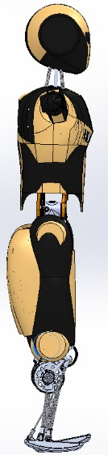
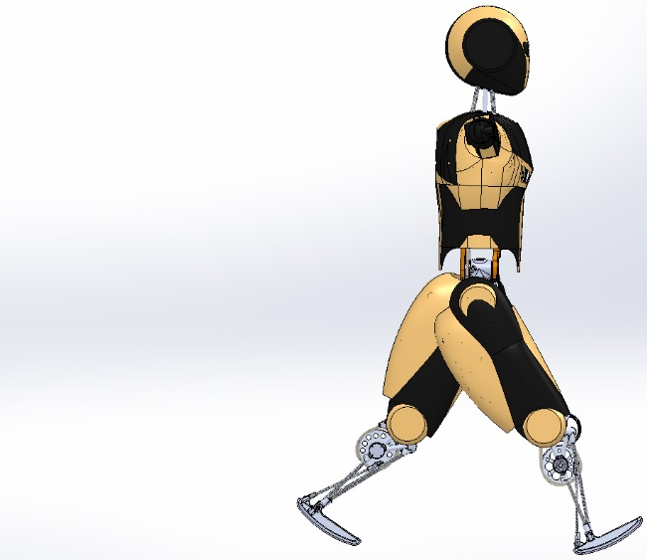

Fast step time
Assume:
Leg inertia$I_{leg}=3 kg{ m}^{2}$
Target $θ_{swing}=1$rad
Target $t_{swing}=0.2$seconds
Speed up as fast as possible for half the swing
Then slow down as fast as possible
$ω_{peak}=2\left({0.5 rad}/{0.1 sec}\right)=10{rad}/{sec}$.
$$α=\frac{2({θ_{swing}}/2)}{{({t_{swing}}/2)}^{2}}=100 rad/s^{2}$$
and the required average joint torque is:
$$τ=Iα=300 Nm$$
1 rad
0.2 s

Slide 8
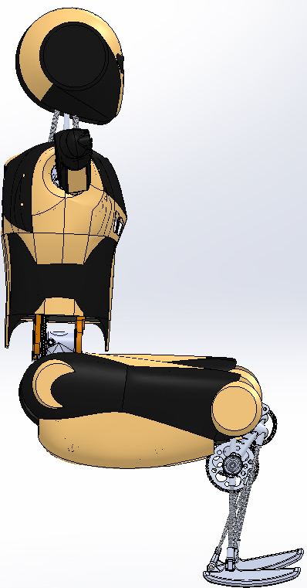
Continuous torque requirements
Sitting
Standing
Stair climbing
~800 N
0.5 m
Continuous torque = 200 N m in knee and hip

Slide 9
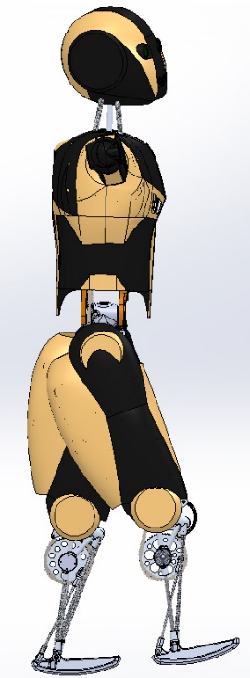



Optimize gear ratios for minimum COT
Block diagram for actuator energy flow
Battery and control electronics
Joint – ankle, knee, or leg swing
$$V,I$$
$τ_{motor}$, $ω_{motor}$
Gear reduction
$τ_{joint}$, $ω_{joint}$
Motor
Bidirectional, includes regeneration for negative work
Cost of Transport (COT) for power from battery, motors only
Gear ratios are constrained to meet a 400 Nm peak torque requirement
Ankle, knee, and hip joints
Walking at 1.4 m/s
Actuators follow Winter (2009) human gait joint velocities and torques
Includes friction and drag
Scaled human gait data

Slide 10
COT optimization results
Motor | Mass (kg) | Peak torque (Nm) | Cont. torque no cooling (Nm) | Rotor inertia (kg m^2) | Motor constant (kg m/W^0.5) | Ankle gear ratio | Knee gear ratio | Hip swing gear ratio | Maximum reflected inertia (kg-m^2) | Maximum heating at 200 Nm torque (W) | COT
RoboDrive ILM70x18HS | 0.340 | 4 | 1.25 | 340E-7 | 0.255 | 110 | 100 | 100 | 0.34 | 62 | 0.198
RoboDrive ILM85x23HS | 0.550 | 7.3 | 2.3 | 980E-7 | 0.426 | 60 | 87 | 87 | 0.74 | 29 | 0.194
RoboDrive ILM115x25HS | 1.2 | 18 | 5.4 | 3650E-7 | 0.880 | 30 | 37 | 37 | 0.50 | 38 | 0.178
Emoteq HS02302 | 0.309 | 5.7 (claimed) | 1.2 | 213E-7 | 0.131 | 153 | 78 | 138 | 0.40 | 383 | 0.198
(Acknowledgement – thanks to Jonathan Hurst and his lab at OSU for telling me about RoboDrive.)

Slide 11
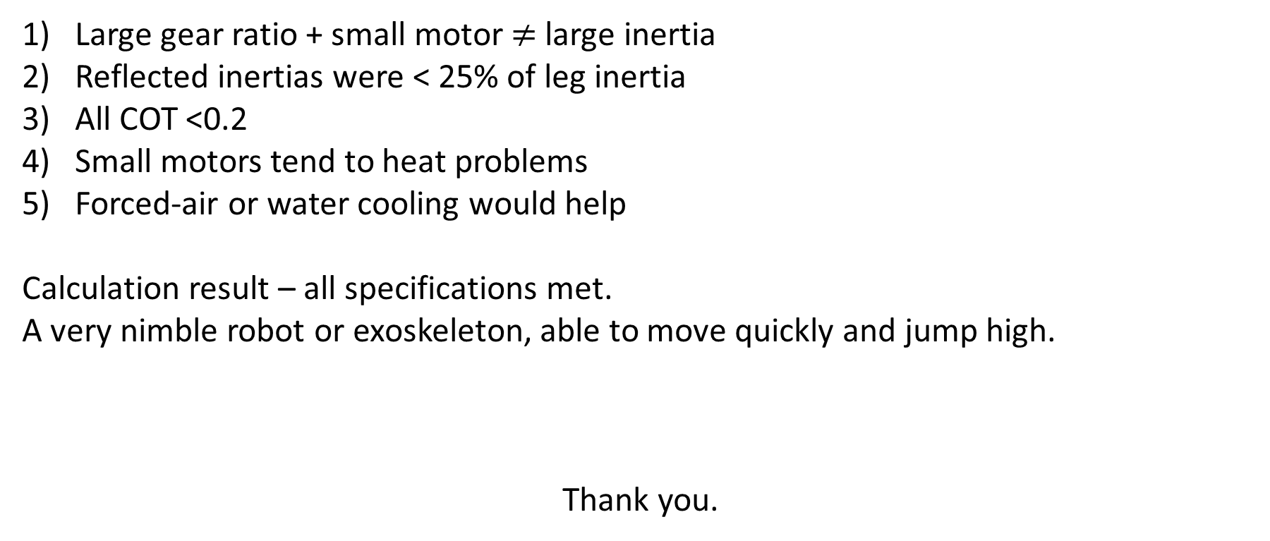
Discussion
Large gear ratio + small motor $≠$ large inertia
Reflected inertias were < 25% of leg inertia
All COT <0.2
Small motors tend to heat problems
Forced-air or water cooling would help
Calculation result – all specifications met.
A very nimble robot or exoskeleton, able to move quickly and jump high.
Thank you.

Slide 12
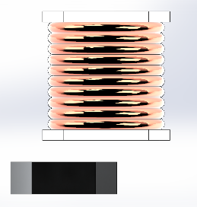

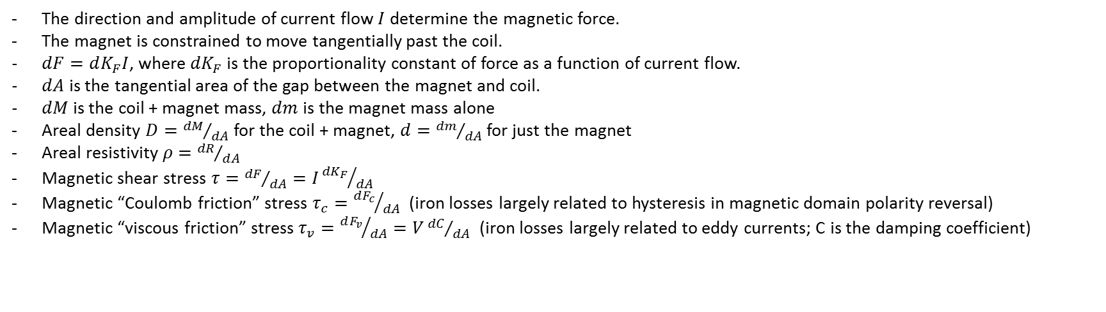
Start with a tiny segment of a motor:
N
Electromagnet coil in stator
S
S
$$dF, V$$
Permanent magnet in rotor
N
The direction and amplitude of current flow $I$ determine the magnetic force.
The magnet is constrained to move tangentially past the coil.
$dF=dK_{F}I$, where ${dK}_{F}$ is the proportionality constant of force as a function of current flow.
$dA$ is the tangential area of the gap between the magnet and coil.
$dM$ is the coil + magnet mass, $dm$ is the magnet mass alone
Areal density $D={dM}/{dA}$for the coil + magnet, $d={dm}/{dA}$ for just the magnet
Areal resistivity $ρ={dR}/{dA}$
Magnetic shear stress $τ={dF}/{dA}=I{{dK}_{F}}/{dA}$
Magnetic “Coulomb friction” stress $τ_{c}={dF_{c}}/{dA}$ (iron losses largely related to hysteresis in magnetic domain polarity reversal)
Magnetic “viscous friction” stress $τ_{v}={dF_{v}}/{dA}=V{dC}/{dA}$ (iron losses largely related to eddy currents; C is the damping coefficient)

Slide 13
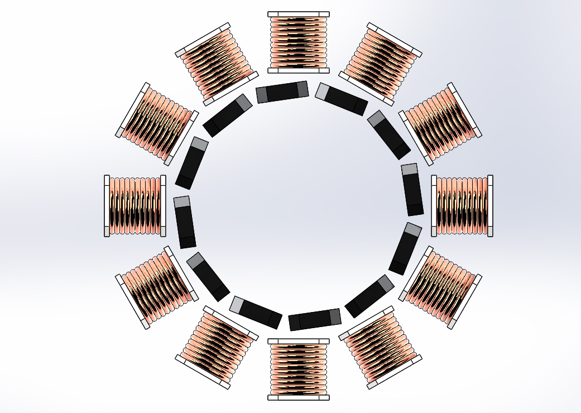
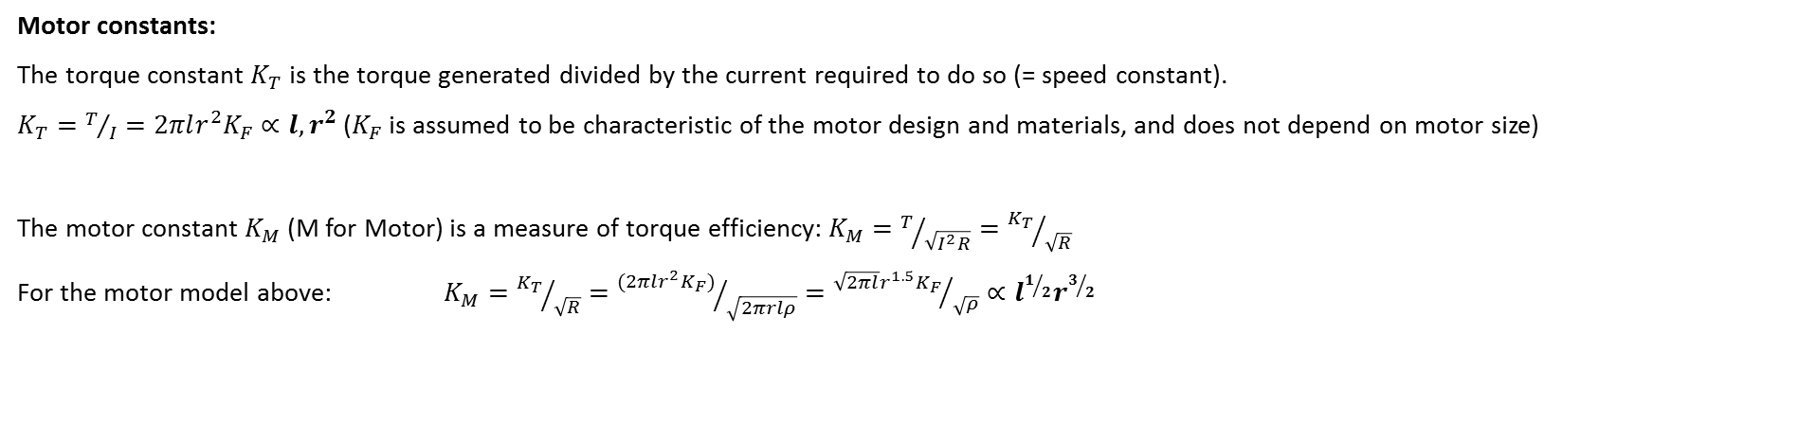
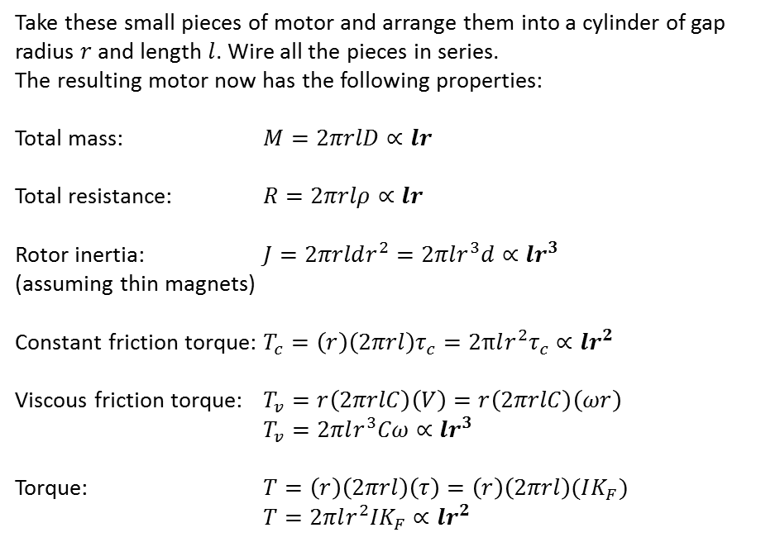
Then put the pieces together to form a whole motor:
Take these small pieces of motor and arrange them into a cylinder of gap radius $r$ and length $l$. Wire all the pieces in series.
The resulting motor now has the following properties:
Total mass: $M=2πrlD∝lr$
Total resistance: $R=2πrlρ∝lr$
Rotor inertia: $J=2πrldr^{2}=2πlr^{3}d∝lr^{3}$
(assuming thin magnets)
Constant friction torque: $T_{c}=\left(r\right)\left(2πrl\right)τ_{c}=2πlr^{2}τ_{c}∝lr^{2}$
Viscous friction torque: $T_{v}=r\left(2πrlC\right)\left(V\right)=r\left(2πrlC\right)\left(ωr\right)$
$T_{v}=2πlr^{3}Cω∝lr^{3}$
Torque: $T=\left(r\right)\left(2πrl\right)\left(τ\right)=\left(r\right)\left(2πrl\right)(IK_{F})$
$T=2πlr^{2}IK_{F}∝lr^{2}$
$$r$$
Motor constants:
The torque constant $K_{T}$ is the torque generated divided by the current required to do so (= speed constant).
$K_{T}=T/I=2πlr^{2}K_{F}∝l,r^{2}$ ($K_{F}$ is assumed to be characteristic of the motor design and materials, and does not depend on motor size)
The motor constant${ K}_{M}$ (M for Motor) is a measure of torque efficiency: $K_{M}=T/{\sqrt{I^{2}R}}={K_{T}}/{\sqrt{R}}$
For the motor model above: $K_{M}={K_{T}}/{\sqrt{R}}={(2πlr^{2}K_{F})}/{\sqrt{2πrlρ}}={\sqrt{2πl}r^{1.5}K_{F}}/{\sqrt{ρ}}∝l^{1/2}r^{3/2}$

Slide 14
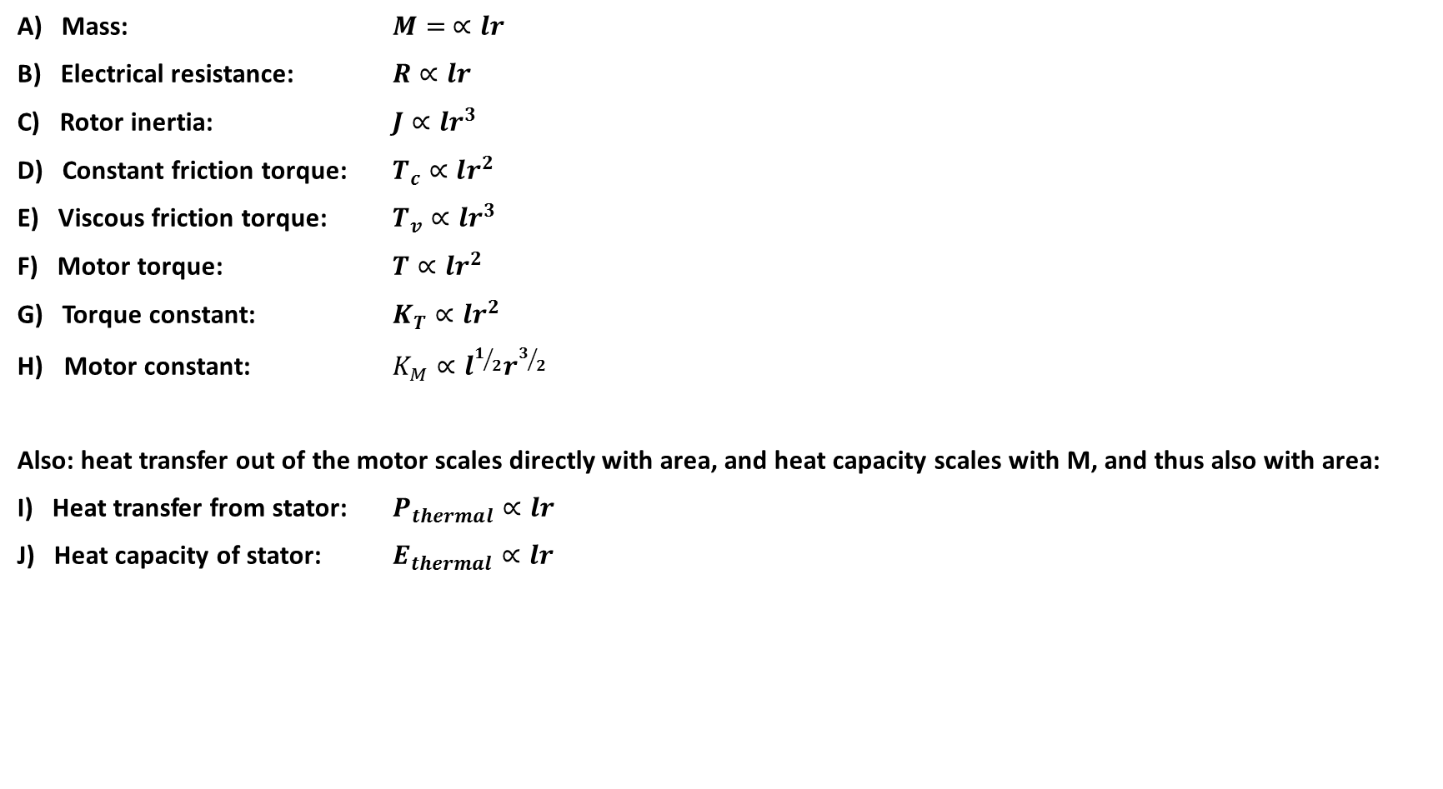
Motor size scaling summary:
A) Mass: $M= ∝lr$
B) Electrical resistance: $R∝lr$
C) Rotor inertia: $J∝lr^{3}$
D) Constant friction torque: $T_{c}∝lr^{2}$
E) Viscous friction torque: $T_{v}∝lr^{3}$
F) Motor torque: $T∝lr^{2}$
G) Torque constant: $K_{T}∝lr^{2}$
Motor constant: $K_{M}∝l^{1/2}r^{3/2}$
Also: heat transfer out of the motor scales directly with area, and heat capacity scales with M, and thus also with area:
I) Heat transfer from stator: $P_{thermal}∝lr$
J) Heat capacity of stator: $E_{thermal}∝lr$

Slide 15
Performance specifications
Some possible actuator requirements for human-level locomotion:
Rapid leg swing for robust foot-placement balance.
Target: 0.2 seconds for a 1-radian step size. This is comparable to humans (and Boston Dynamics’s BigDog).
Sustained joint torque.
Target: “wall sit” for > 1 minute.
Peak joint torque.
Target: 1-leg “wall sit” for > 1 second.
Motor cost of transport (COT) for normal walking.
Target: < 0.2

Slide 16
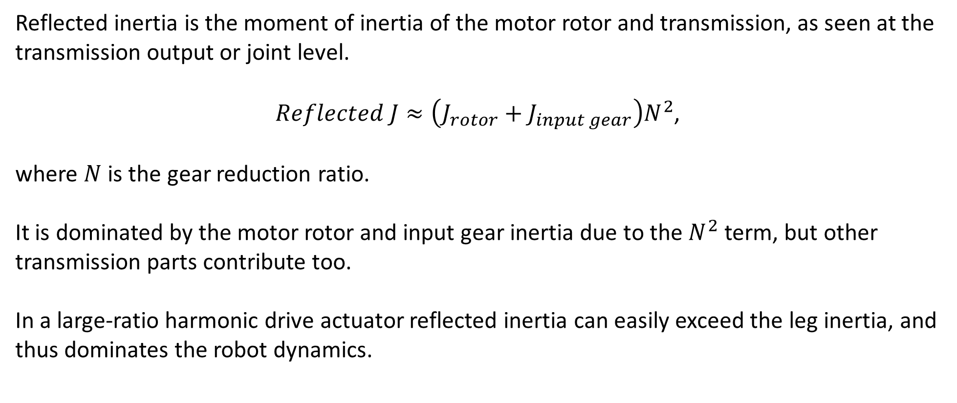
What is “reflected inertia”?
Reflected inertia is the moment of inertia of the motor rotor and transmission, as seen at the transmission output or joint level.
$Reflected J≈\left(J_{rotor}+J_{input gear}\right)N^{2}$,
where $N$ is the gear reduction ratio.
It is dominated by the motor rotor and input gear inertia due to the $N^{2}$ term, but other transmission parts contribute too.
In a large-ratio harmonic drive actuator reflected inertia can easily exceed the leg inertia, and thus dominates the robot dynamics.

Slide 17
Collisions
Reflected inertia adds to the impact forces during collisions, and can break hardware.
Some solutions:
High peak actuator torques, so the leg and transmission can “run away” from an external collision torque.
Some compliance in series with the actuator, to increase the available response time. Depending upon the stiffness of the robot structure, added compliance may not be needed.
Passive over-torque slip clutches

Slide 18
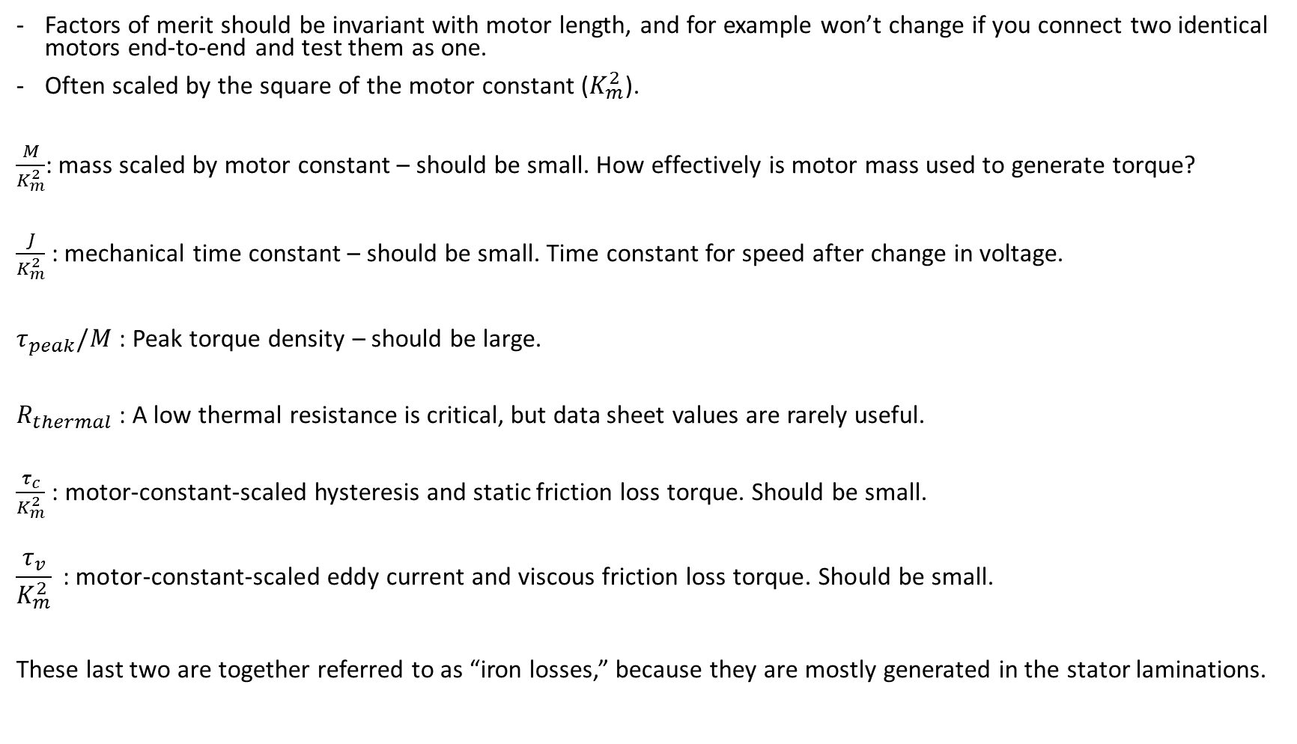
Factors of merit and metrics for motors
Factors of merit should be invariant with motor length, and for example won’t change if you connect two identical motors end-to-end and test them as one.
Often scaled by the square of the motor constant ($K_{m}^{2}$).
$\frac{M}{K_{m}^{2}}$: mass scaled by motor constant – should be small. How effectively is motor mass used to generate torque?
$\frac{J}{K_{m}^{2}}$: mechanical time constant – should be small. Time constant for speed after change in voltage.
$τ_{peak}/M$ : Peak torque density – should be large.
$R_{thermal}$ : A low thermal resistance is critical, but data sheet values are rarely useful.
$\frac{τ_{c}}{K_{m}^{2}}$ : motor-constant-scaled hysteresis and static friction loss torque. Should be small.
$$\frac{τ_{v}}{K_{m}^{2}}\text{ : }\text{motor}\text{-}\text{constant}\text{-}\text{scaled} \text{eddy} \text{current} \text{and} \text{viscous} \text{friction} \text{loss} \text{torque}\text{. }\text{Should} \text{be} \text{small}\text{.}$$
These last two are together referred to as “iron losses,” because they are mostly generated in the stator laminations.

Slide 19
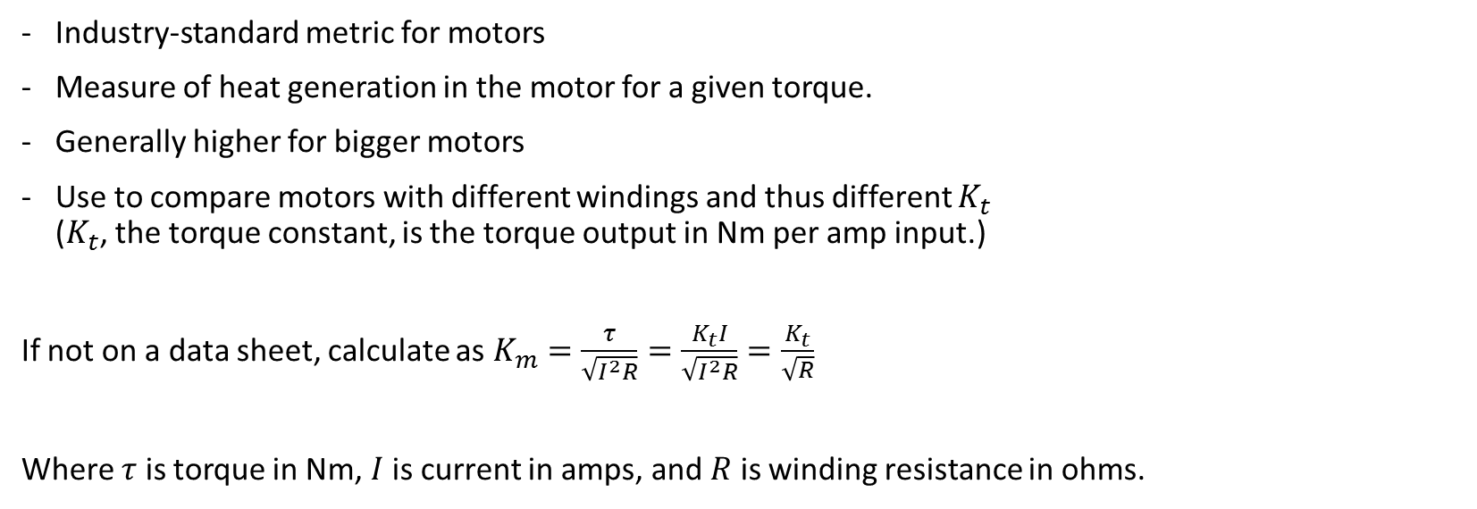


Motor constant $K_{m}$
Industry-standard metric for motors
Measure of heat generation in the motor for a given torque.
Generally higher for bigger motors
Use to compare motors with different windings and thus different $K_{t}$
($K_{t}$, the torque constant, is the torque output in Nm per amp input.)
If not on a data sheet, calculate as $K_{m}=\frac{τ}{\sqrt{I^{2}R}}=\frac{K_{t}I}{\sqrt{I^{2}R}}=\frac{K_{t}}{\sqrt{R}}$
Where $τ$ is torque in Nm, $I$ is current in amps, and $R$ is winding resistance in ohms.
Identical motors connected in series
$$K_{m}$$
$$K_{m}$$
$$K_{m}\left(total\right)= \sqrt{2}K_{m}$$

Slide 20
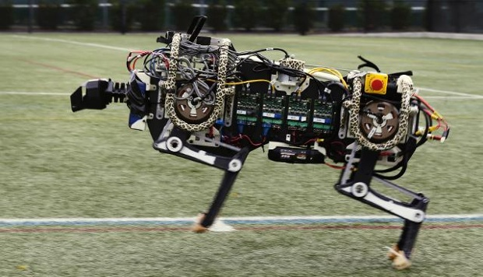
Other approaches to robot actuators
1) Use large-diameter motors with little or no gear reduction?
No. The MIT Cheetah is an impressive example of this strategy, but it could do even better with more gear reduction.
Problems:
Lower power-to-weight ratio. Why is that? Magnetic stresses in a motor are at about 50 kPa – steel can easily exceed 500 MPa! So a gearbox can give you more torque with less weight.
Inefficient, because the motors are operating well below their optimum RPM. 76% of its motor power budget is spent heating the motor windings.
Risk of overheating and motor damage.
(Seok et. al., 2015)
MIT Cheetah robot (AP Photo/Charles Krupa)

Slide 21
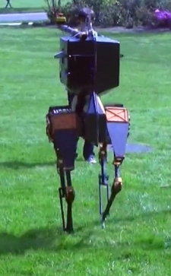
Other approaches to robot actuators
2) Large energy-storage springs in the legs?
No. Large series or parallel springs can help with some highly dynamic robot behaviors, but they are not required in general.
Problems
Great for getting a (single) dynamic and efficient gait
In the way of control for other robot activities.
Add complexity, bulk, and weight.
Over half of the energy recovery of springs can be achieved with regeneration. The MIT Cheetah robot was shown to recover 63% of its bounce energy and return it to the battery. (Seok et. al., 2015)
ATRIAS robot, Oregon State University

Slide 22
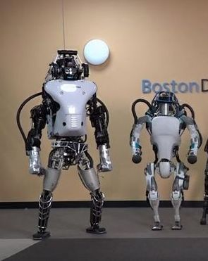
Other approaches to robot actuators
3) Hydraulic actuators?
No. Boston Dynamics has demonstrated the high power and flexible, robust actuation that can be achieved with these, but they are not the only way to do this.
Problems:
Power-hungry
Expensive
Risk of leaks
With air-powered robots the leak risk is reduced, but the controllability is much worse and so is the efficiency.
Atlas robots from Boston Dynamics (YouTube)

Slide 23
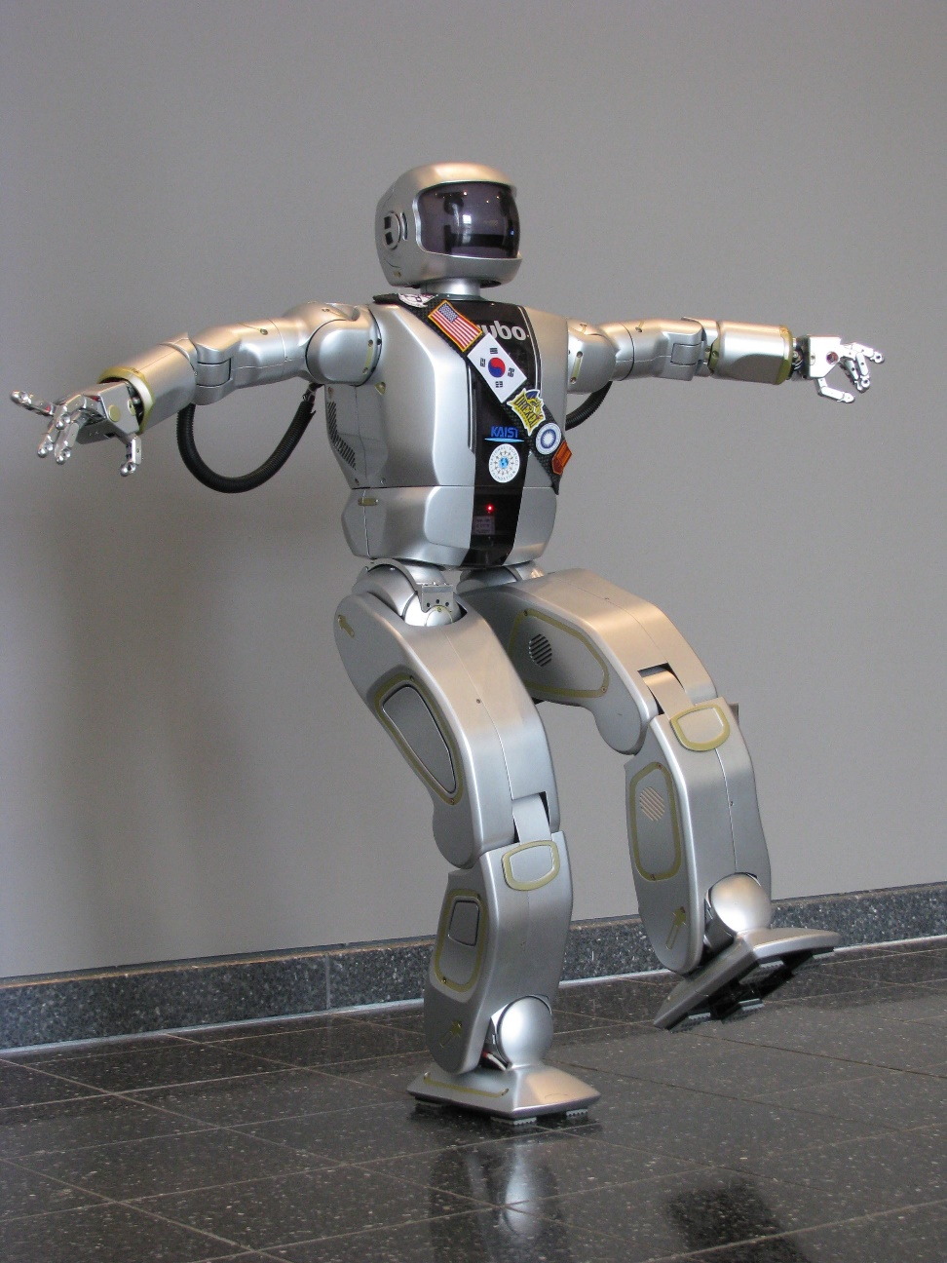
Other approaches to robot actuators
4) Harmonic drives with large gear reduction ratios?
No. Harmonic drives are compact and backlash-free, but when used in legged machines they result in motion that is slow, stiff, and “robotic.”
Problems:
Not very energy-efficient
Expensive
Large input inertias coupled directly to high-speed motor shafts, leading to very high “reflected inertia” in the leg.
What is reflected inertia?
Reflected inertia is the moment of inertia of the motor rotor and transmission, as seen at the transmission output or joint level.
It matters because it increases as the square of the gear ratio.
Hubo robot (KAIST)

Slide 24
Start with a tiny segment of a motor:
N
Electromagnet coil in stator
S
S
$$dF, V$$
Permanent magnet in rotor
N
The direction and amplitude of current flow $I$ determine the magnetic force.
The magnet is constrained to move tangentially past the coil.
$dF=dK_{F}I$, where ${dK}_{F}$ is the proportionality constant of force as a function of current flow.
$dA$ is the tangential area of the gap between the magnet and coil.
$dM$ is the coil + magnet mass, $dm$ is the magnet mass alone
Areal density $D={dM}/{dA}$for the coil + magnet, $d={dm}/{dA}$ for just the magnet
Areal resistivity $ρ={dR}/{dA}$
Magnetic shear stress $τ={dF}/{dA}=I{{dK}_{F}}/{dA}$
Magnetic “Coulomb friction” stress $τ_{c}={dF_{c}}/{dA}$ (iron losses largely related to hysteresis in magnetic domain polarity reversal)
Magnetic “viscous friction” stress $τ_{v}={dF_{v}}/{dA}=V{dC}/{dA}$ (iron losses largely related to eddy currents; C is the damping coefficient)

Slide 25
Motor comparison charts
RoboDrive: ILM25HS, ILM50x08HS, ILM50x14HS, ILM70x18HS, ILM85x25HS
Maxon: EC30-4P-200W
Kollmorgen: RBE(H)-01213
Moog: DB-2000-D-1ES, DB-3000-H-1ES
Emoteq: HS02301, HS02302, HT5001
Parker: K064100
Note: the Maxon motor mass includes the case; the others are rotor/stator sets.

Slide 26
Motor comparison charts (continued)
RoboDrive: ILM25HS, ILM50x08HS, ILM50x14HS, ILM70x18HS, ILM85x25HS
Maxon: EC30-4P-200W
Kollmorgen: RBE(H)-01213
Moog: DB-2000-D-1ES, DB-3000-H-1ES
Emoteq: HS02301, HS02302, HT5001
Parker: K064100
Note: the Maxon motor mass includes the case; the others are rotor/stator sets.

Slide 27
Use human walking gait to check energy use
MATLAB script to calculate power into or out of the battery for a three-DOF leg model (leg swing, knee, ankle).
Uses Winter’s gait data (Winter, 2009) for a 57 kg human walking at 1.4 m/s, scaled to 100 kg.
Block diagram for actuator energy flow
Battery and control electronics
Joint – ankle, knee, or leg swing
$$V,I$$
$τ_{motor}$, $ω_{motor}$
Gear reduction
$τ_{joint}$, $ω_{joint}$
Motor
Bidirectional, includes regeneration for negative work
Optimization parameters:
Motor constant (copper losses)
Motor static and viscous friction (iron losses)
Rotor inertia
Effective transmission inertia
Battery and controller efficiency
Transmission static and torque-proportional friction
Robot mass, for torque scaling
Output: gear ratios for minimum Cost of Transport (COT) from battery, motor drive only (no sensors, computers, etc.)
Human gait data

